Slide 1
Equations of Circles

Slide 2
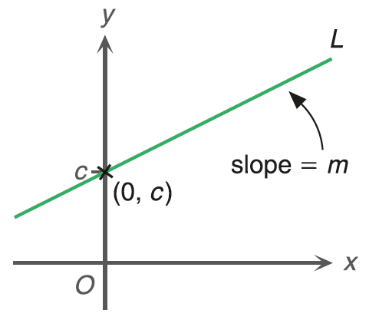
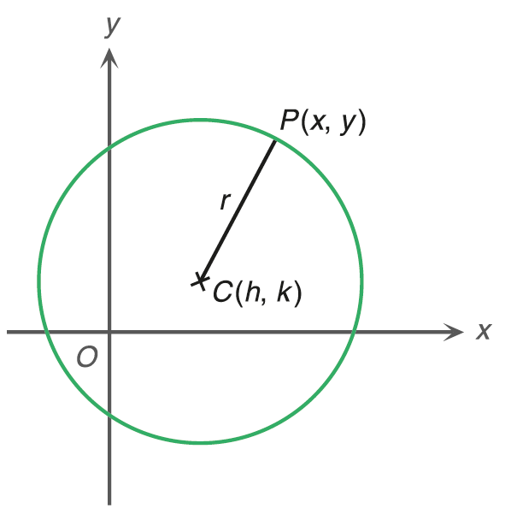

Equations of Circles
Previously, we learnt how to describe a straight line on a rectangular coordinate plane by an equation.
The equation of this straight line is y = mx + c.
i.e. The coordinates of all the points on the straight line satisfy this equation.
How can we do the same thing with circles?

Slide 3
Standard Form
A circle is a closed curve
such that every point on it
is at the same distance
from a fixed point.
y
The fixed point is the centre.
P

r
The fixed distance is the radius.

C(h, k)
x
O

Slide 4
Let (x, y) be the coordinates of P.
y
PC
= r
h
k
r
P
(x, y)

h
k
r
r
By the distance formula

Square both sides.
C(h, k)
The coordinates of all the points on the circle centred at C(h, k) with radius r satisfy this equation.
x
O

Slide 5
Therefore, the equation of the circle centred at C(h, k) with radius r is given by:
h
k
r
This is known as the standard form or centre-radius form of the equation of a circle.
For example, the equation of the circle centred at C(0, 2) with radius 3 is given by
(x – 0)² + (y – 2)² = 3²
i.e. x² + (y – 2)² = 9

Slide 6
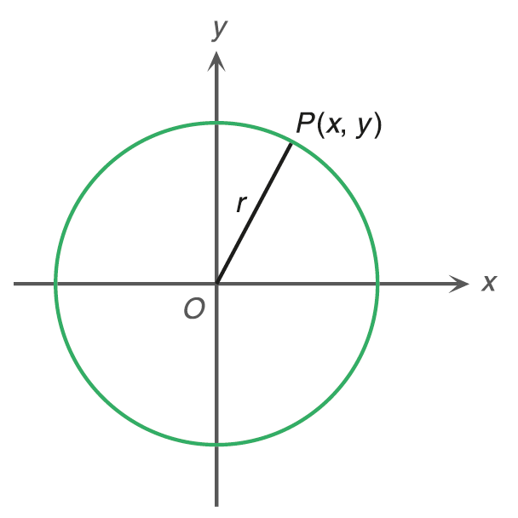


In particular, if a circle is centred at the origin with radius r,
the equation of the circle is
◄ By substituting h = 0 and k = 0 into (x – h)² + (y – k)² = r².

Slide 7
Follow-up question
Find the equation of each of the following circles with the given centre C and radius r. (Leave your answers in the standard form.)
(a) C(2, 1), r = 2 (b) C(0, 0), r = 3
(a) The equation of the circle is
i.e.

Slide 8
Follow-up question
Find the equation of each of the following circles with the given centre C and radius r. (Leave your answers in the standard form.)
(a) C(2, 1), r = 2 (b) C(0, 0), r = 3
(b) The equation of the circle is
i.e.

Slide 9

Finding the Centre and Radius of a Circle
For a circle (x – h)² + (y – k)² = r²,
centre = (h, k)
radius = r
If the equation of a circle is in the form (x – h)² + (y – k)² = r², we can find the centre and the radius of the circle.
Example: x² + (y + 1)² = 16
(x – 0)² + [y – (–1)]² = 4²
Centre =
,
radius =

Slide 10
Follow-up question
For each of the following equations of circles, find the centre and the radius of the circle.
(a) (x + 1)² + (y – 2)² = 16
(b) 9(x – 3)² + 9(y + 3)² = 25
(a) (x + 1)² + (y – 2)² = 16
[x – (–1)]² + (y – 2)² = 4²
∴ Centre = (–1, 2),
radius = 4

Slide 11
Follow-up question
For each of the following equations of circles, find the centre and the radius of the circle.
(a) (x + 1)² + (y – 2)² = 16
(b) 9(x – 3)² + 9(y + 3)² = 25
(b) 9(x – 3)² + 9(y + 3)² = 25
Express the equation in the form (x – h)² + (y – k)² = r².
∴ Centre = (3, –3),
radius =

Slide 12
General Form
If we expand the left-hand side of the equation (x – h)² + (y – k)² = r², we have
(x² – 2hx + h²) + (y² – 2ky + k²) = r²
x² + y² – 2hx – 2ky + h² + k² – r² = 0
– 2h
– 2k
h² + k² – r²
Let
D = – 2h,
E = – 2k and
F = h² + k² – r².
Then,
x² + y² + Dx + Ey + F = 0, where D, E and F are constants.
In fact, the equation of any circle can be simplified to this form. We call this the general form of the equation of a circle.
Note that , and .

Slide 13
Do you notice any characteristics from the general form of the equation of a circle?
x² + y² + Dx + Ey + F = 0
(1) The equation is quadratic, i.e. the highest degree of all its terms is 2.
(2) The coefficients of both x² and y² are equal to 1.
(3) The equation has no xy term.

Slide 14
Follow-up question
Determine whether each of the following equations represents a circle. If yes, put a '' in the box; otherwise, put a ''.
(a) x² + y² + 4y – 9 = 0
(b) 3x² + 2y² + 3x + 2y + 8 = 0
(c) x⁴ + y⁴ + 4x + 7y – 7 = 0
(d) x² + y² – 2xy + 6y – 11 = 0





Slide 15
Finding the Centre and Radius of a Circle
Consider a circle with centre (h, k) and radius r.
Standard form: (x – h)² + (y – k)² = r²
General form: x² + y² + Dx + Ey + F = 0
D = –2h
E = –2k
F = h² + k² – r²

Slide 16
Given the general form of the equation of a circle
x² + y² + Dx + Ey + F = 0. Then

Slide 17
Example:
D
E
F
For the circle x² + y² – 4x + 8y + 4 = 0,
⎛
D
E
⎞
radius
centre =
⎜
−
,
−
|
⎝
2
2
⎠
⎛
(
−
4
)
8
⎞
=
−
−
|
⎜
,
⎝
2
2
⎠
=
−
(
2
,
4
)

Slide 18
Follow-up question
For each of the following equations of circles, find the centre and the radius of the circle.
(a) x² + y² + 12x – 2y + 28 = 0
(b) 4x² + 4y² + 24x – 4y + 33 = 0
(a)

Slide 19
Follow-up question
For each of the following equations of circles, find the centre and the radius of the circle.
(a) x² + y² + 12x – 2y + 28 = 0
(b) 4x² + 4y² + 24x – 4y + 33 = 0
Remember to convert the coefficients of x² and y² to 1.
(b)

Slide 20
Nature of a Circle
Consider the expression for the radius of the circle,
i.e.
r
r
r
> 0
If
r > 0
This circle is a real circle.
= 0
If
r = 0
radius = 0
This circle is a point circle.
< 0
If
r is NOT a real number
The circle does NOT exist.
This circle is an imaginary circle.

Slide 21
Follow-up question
Find the range of values of F if the equation x² + y² + 4x + 6y + F = 0 represents an imaginary circle.
∵ The equation represents an imaginary circle.
∴

Slide 22

Finding the Equations of Circles under Different Given Conditions
In situations where the centre and the radius of a circle are not known, we may use given points on a circle to find its equation.

Slide 23
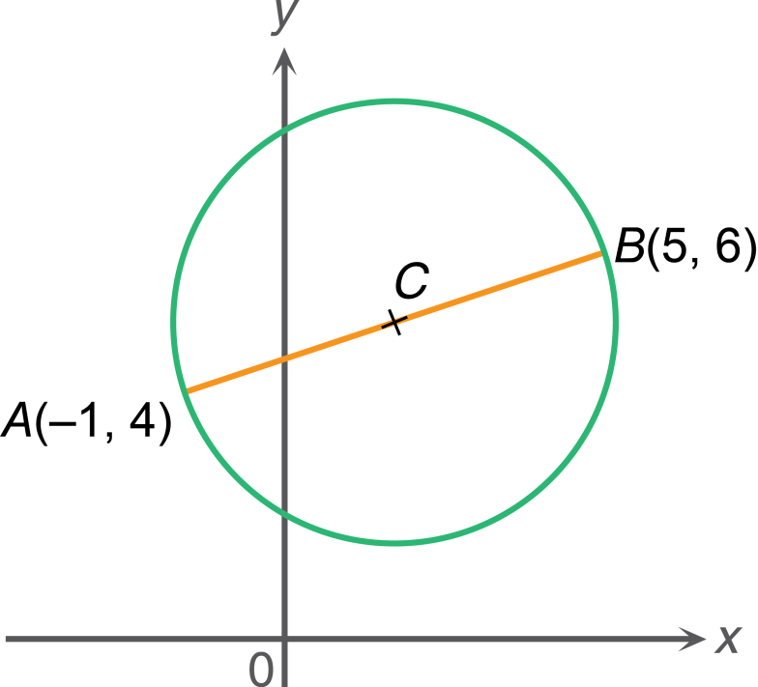

It is given that A(–1, 4) and B(5, 6) are the end points of a diameter of a circle. Find the equation of the circle.
We can make use of the given conditions to find the centre and the radius of the circle.

Slide 24
It is given that A(–1, 4) and B(5, 6) are the end points of a diameter of a circle. Find the equation of the circle.
The centre is the mid-point of the diameter AB.
The coordinates of the mid-point of AB can be found by the mid-point formula.

Slide 25
It is given that A(–1, 4) and B(5, 6) are the end points of a diameter of a circle. Find the equation of the circle.
Let C be the centre of the circle.
∵ C is the mid-point of AB.
∴ Coordinates of C

Slide 26
It is given that A(–1, 4) and B(5, 6) are the end points of a diameter of a circle. Find the equation of the circle.
The length of CA is the radius of the circle.
The length of CA can be found by the distance formula.

Slide 27
It is given that A(–1, 4) and B(5, 6) are the end points of a diameter of a circle. Find the equation of the circle.
Let C be the centre of the circle.
∵ C is the mid-point of AB.
∴ Coordinates of C
Radius of the circle
∴ The equation of the circle is (x – 2)² + (y – 5)² = 10.

Slide 28
It is given that O(0, 0), A(2, 2) and B(–4, –2) are points on a circle. Find the equation of the circle.
The coordinates of points on the circle must satisfy the equation of the circle.

Slide 29
It is given that O(0, 0), A(2, 2) and B(–4, –2) are points on a circle. Find the equation of the circle.
By substituting the coordinates of the three given points into x² + y² + Dx + Ey + F = 0, we can solve for the values of D, E and F.

Slide 30
It is given that O(0, 0), A(2, 2) and B(–4, –2) are points on a circle. Find the equation of the circle.
Let x² + y² + Dx + Ey + F = 0 be the equation of the circle.
∵ O(0, 0), A(2, 2) and B(–4, –2) are points on a circle.
∴ By substitution, we have
0² + 0² + D(0) + E(0) + F = 0
F = 0 ......(1)
2² + 2² + D(2) + E(2) + F = 0
2D + 2E + F = –8 ......(2)
(–4)² + (–2)² + D(–4) + E(–2) + F = 0
4D + 2E – F = 20 ......(3)

Slide 31
By substituting (1) into (2), we have
2D + 2E = –8
D + E = –4 ......(4)
By substituting (1) into (3), we have
4D + 2E = 20
2D + E = 10 ......(5)
(5) – (4):
D = 14
By substituting D = 14 into (4), we have
14 + E = –4
E = –18
∴ The equation of the circle is x² + y² + 14x – 18y = 0.

